Slide 1

Sub- metered Household Data
Armin Sanson R

Slide 2
Goals for the Analysis
What are the typical power usage patterns for each sub-meter?
Are these "typical" patterns true for the time period in question?
If not, what, if anything, can be used to help support the use of sub-meters?
Are there any recommendations for questions we should be asking?

Slide 3
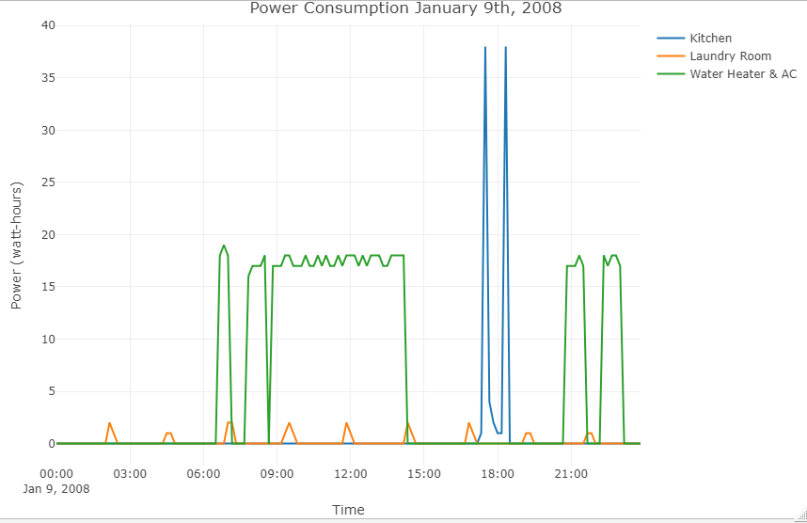
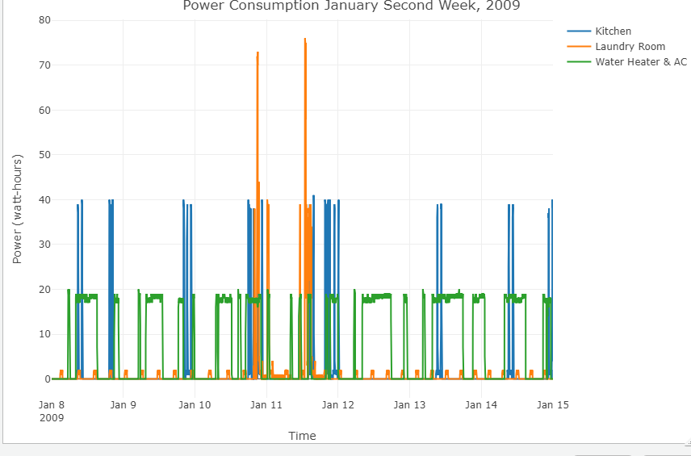
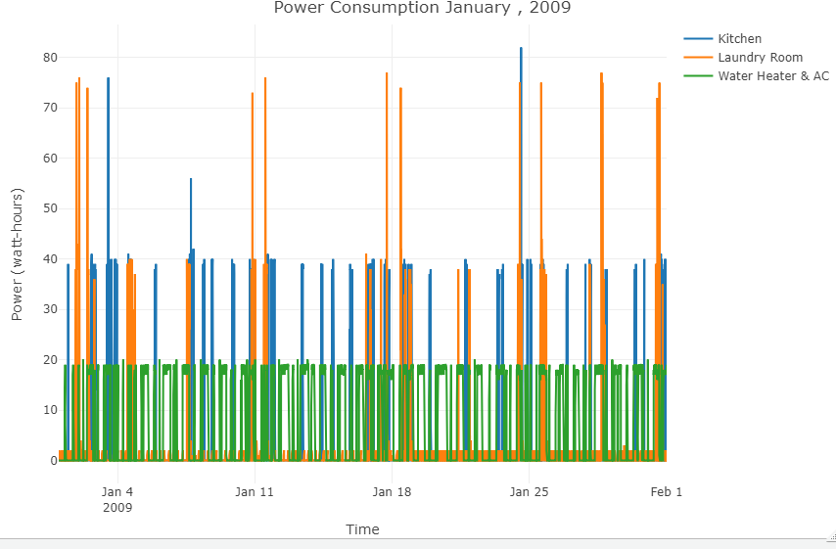
Below illustrates the power consumption for a day, week and month :
Kitchen has high consumption between 6 – 7 PM
Laundry room is consistent throughout day, but high consumption during the weekends
Water heater and AC: Consistent throughout the month and majority high between 9 AM to 3 PM

Slide 4
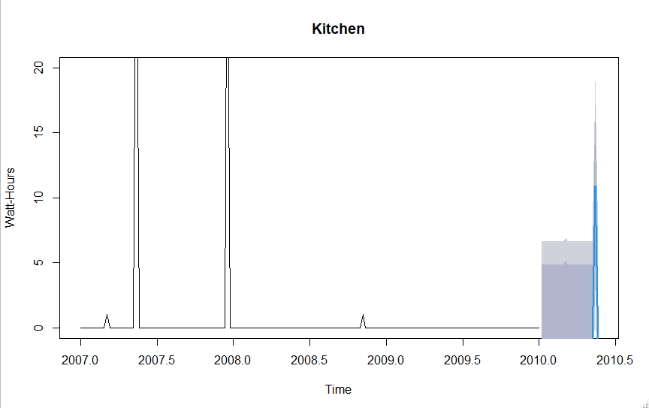
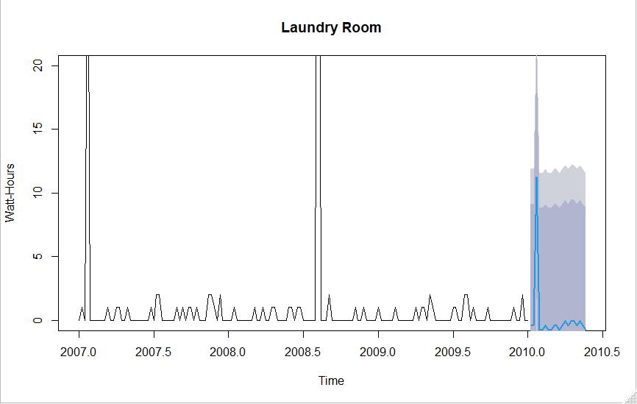
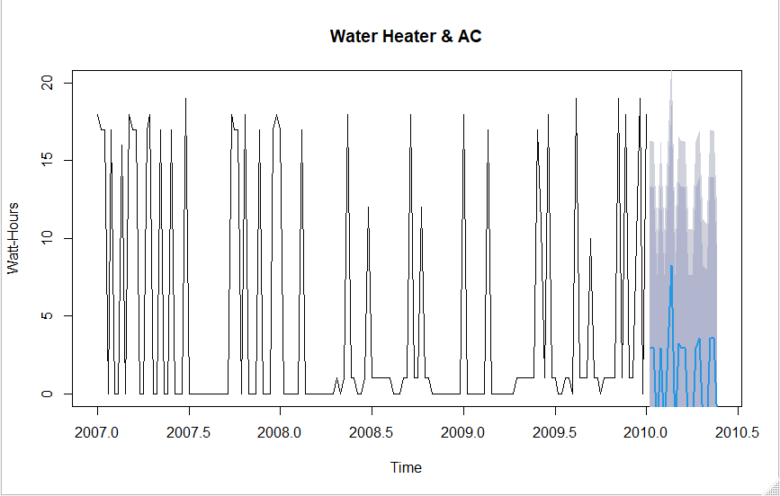
Below visualizes the forecast consumption 20 time ahead with confidence level of over 80%
R- squared: 0.34
RSME: 4.13
R- squared: 0.33
RSME: 6.3
R- squared: 0.38
RSME: 6.8

Slide 5
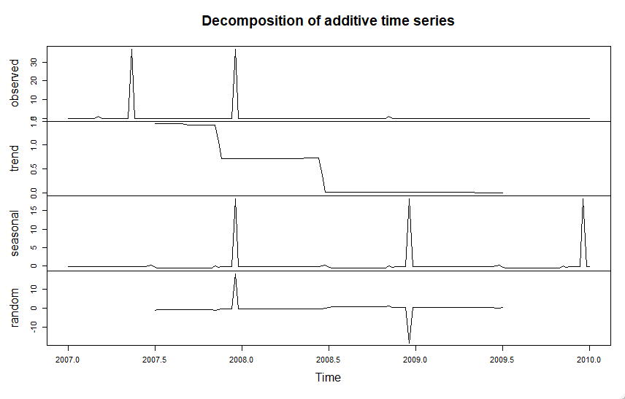
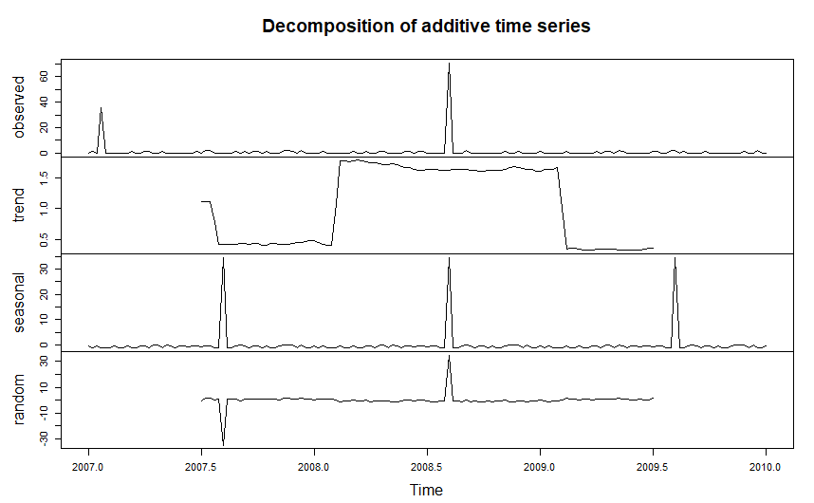
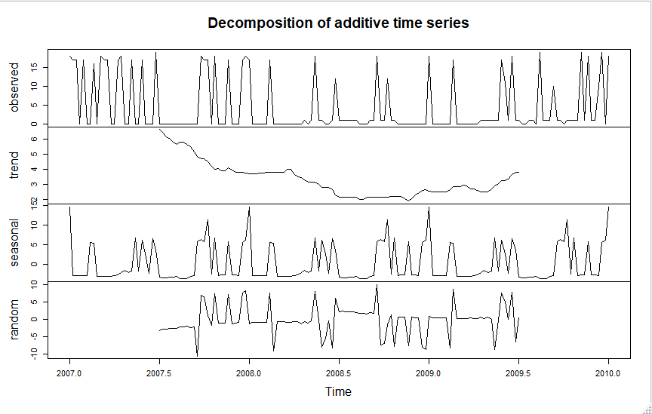
The Decomposition of data shows a gradual drop with Kitchen, water Heater and AC consumption and seasonal variation with laundry.
Kitchen
Laundry
Water Heater and AC

Slide 6
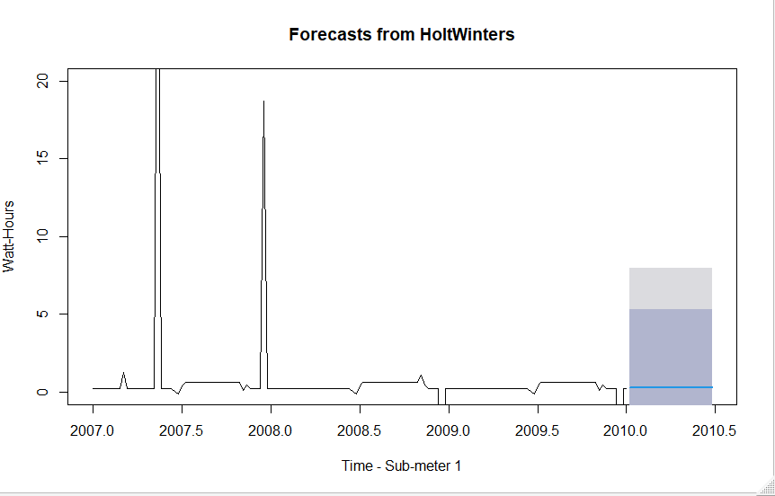
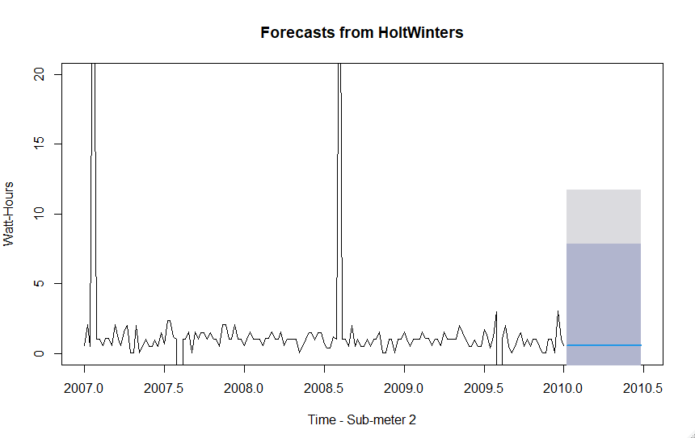
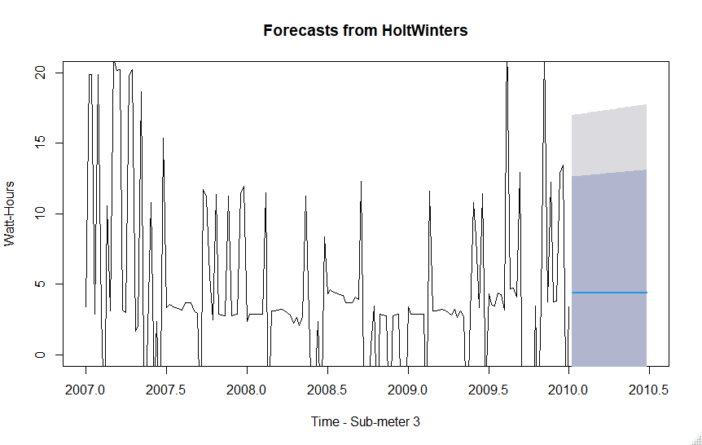
Holt Winter Forecasting removes the seasonal variation and smoothens the forecasting
Below illustrate a pick in usage for Laundry , water Heater and AC usage last 5 month of 2019 and a dip in Kitchen usage.
Kitchen
Laundry
Water Heater and AC

Slide 7
Correlation
After removing the seasonal variance, there is correlation between submeters
Kitchen and Laundry are most likely to close to 1 Watt-hours
Water Heater and AC is most likely to use 4 Watt-hours

Slide 8
Summary and Recommendation
There are some missing data in Sub meter 1 and 2 . There should be a better way to record the data in a way that if there is outage, we can identify it form data.
We removed the seasonal variance in our forecast. Power usage is very seasonal and if we want to have an accurate forecasting we need to include the seasonal variance.
AC data outweigh the water heater data they might not be correlated. To get the better data, we should separate the submeters

Slide 9
Lessons learned
Visualizations and time serious plots
Forecasting via Visualizations and time serious plots
Removing and adding seasonal and periodical shifts

